Slide 1
PV solar optimal MPPT under shading
(Project – Fall 2016)
Arifin. Arif
Mohammed Abdul Rafae
Walid Misbah

Slide 2
Introduction
The Conventional Energy Sources are exhausting at an alarming rate.
So there is an urgent and strong need to move towards the Non-Conventional Energy Sources.
One of the Most abundantly available energy resource is Solar Energy.
Over the recent years, efforts have gone into tapping this energy source using the solar cells and has been one of the major contributors towards the renewable energy production.

Slide 3
Introduction
But, these solar cells are vulnerable and hence their efficiency of energy production can be hampered due to factors like shading, Manufacturing defects , etc.
Our aim is to tackle the problem of shading in solar cells.

Slide 4
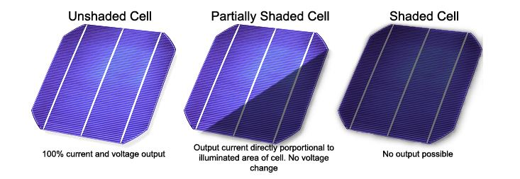
Shading
Shading is phenomenon due to which the sunlight is obstructed from falling on the solar cells and hence reducing the Power Output considerably.
It can be of 2 types:
a) Soft Shading –Partial Blocking of sunlight due clouds.
b) Hard Shading – Physically Obstructing the solar cell by a tree,etc.
Fig:1:Shading of a Solar Panel
Source:http://sargosis.com/how-shade-affects-a-solar-array/

Slide 5
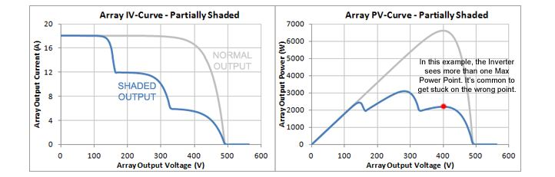
Shading(Contd.)
The graphs below describe how shading effects the Power Output of Solar Panel[2].
Fig:2: I-V and P-V Characteristics of a shaded PV Cell
Source:http://sargosis.com/how-shade-affects-a-solar-array/

Slide 6
Methods
This problem can be solved to an extent by reconfiguring the solar array.
Few Methods are :
1. TCT Configuration
2. Su Do Ku Configuration
3. Genetic Algorithm
The above 3 Methods were implemented and following were the observations[1].

Slide 7
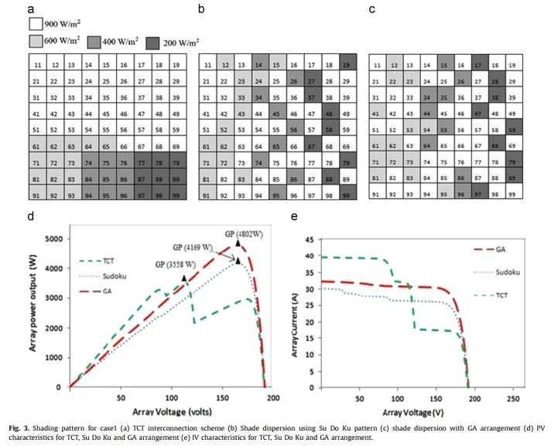
Observation
Fig:1: I-V and P-V Characteristics of solar PV array after reconfiguration
Source: http://www.sciencedirect.com/science/article/pii/S136403211400923X

Slide 8
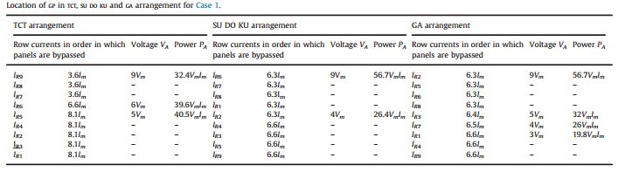
Observation(contd.)
Fig:3: Analysis and Comparision of the 3 Configuration Methods
Source: http://www.sciencedirect.com/science/article/pii/S136403211400923X

Slide 9
Proposed Implementation
We aim to implement the reconfiguration of the cells in PV array by using Game Theory.
Types of strategies in Game Theory
1. Cooperative Form
2. Non-Cooperative Form
In non-cooperative game, players choose their strategy to allocate resources such a way that they can maximize only their own benefits and didn’t consider others benefit.

Slide 10
Game Theory(Contd.)
Unlike non-cooperative games , in cooperative games players arrange their resources to maximize coalitional benefit.
Here we propose a cooperative game theory where:
1) Each column of the solar array are the players.
2) Each player have control over nine solar panels in
its corresponding column.
3) Players or each column choose their actions or strategies to maximize their mutual or coalitional pay offs.
4) They can move solar panels in their respective columns to attain maximum benefits for the whole solar array.

Slide 11
Game Theory(Contd.)
The global benefit of the solar array is obviously total power output of the solar array.
From the TCT configuration we can see that as all the modules of an row array are connected in series .
So, we can maximize the power by maximizing the total current of a row, when bypassing is neglected.
Hereby, the row currents can be a measure of the payoff. As the rows are in series configuration, so the row with the minimum current will dictate the whole solar array current.

Slide 12
Game Theory(Contd.)
Hence , we set the maximum deviations of raw current from their respective maximum without any shading as pay off .
The players will coordinate each other by reallocating their resources to minimize the maximum deviations of the rows current from their maximum.
Pay off/utility=max(I_{m}-I_{n})for n^{th} player; n=1,2,3….8,9;
Objective=min ( max( (I_{m}-I₁),(I_{m}- I₂),(I_{m}-I₃), (I_{m}-I₄),(I_{m}- I₅),(I_{m}-I₆), (I_{m}-I₇),(I_{m}- I₈),(I_{m}-I₉) ) )

Slide 13
Algorithm
Step-1: Define the No of Players and their action sets (which represents the size of the PV Array)
Step-2: Define the Initial position matrix for PV Array (TCT Configuration)
Step-3: Decide the Game Theory Strategy to be used (In this case , we used Min- Max)
Step-4: Form matrix of coalitions using the Players and their Action Sets.

Slide 14
Algorithm(contd.)
Step-5: The result of Step-4 will be the position matrix of each cell in the array. Define a vector for the fraction of shading or the percentage of partial shading.
Step-6: Now determine the result or value of each action performed by the Players for all the action sets i.e Calculate currents generated by each cell for all the coalitions.
Step-7: Now sum up the cell currents to get the total current in the respective row.

Slide 15
Algorithm(contd.)
Step-8: Since , in a PV Array the row having the lowest current dominates/dictates the whole array current. Find the lowest current in all the rows of the array.
Step-9: Repeat Step-8 for all the coalitions generated earlier. Store the result in a vector/array.
Step-10: Now we need to determine the coalition which has the optimal value of lowest current. To achieve this find the max value in the result obtained in step-9. The Index of the maximum value in the result of step-9 will determine the coalition which gives the maximum current in the PV Array.

Slide 16
Algorithm(contd.)
Step-11: Now calculate the Total Output Power of the array by multiplying the total voltage of the array by total current obtained in step-10.
Step-12: Reconfigure the PV Array with the Coalition pattern found in Step 10 and Simulate the performance or behavior.

Slide 17
Code Implementation
The algorithm discussed earlier was implemented in Matlab and Simulink.
The Matlab Code is as follows:

Slide 18
Code Implementation(contd)
clc;
clear all;
nPlayer=input('number of Column='); %Defining the Players
Actions=linspace(1,nPlayer,nPlayer); %Defining the Actions of each player
nAction=length(Actions);
ActionSets=zeros(nAction^nPlayer,nPlayer); % Action Sets Intialization
for n=1:nPlayer % Assigning indivudual action in the
for m=1:size(ActionSets,1) action sets
x=ceil(m/nAction^(n-1));
if rem(x,nAction)>0
ActionSets(m,nPlayer-n+1)=Actions(rem(x,nAction));
else
ActionSets(m,nPlayer-n+1)=Actions(nAction);
end
end
end
ActionSets;

Slide 19
Code Implementation(contd)
Imax=1;
Iradiance=[.9 .6 .3 .1]; %Defining the fractional values of the
for Action=1:size(ActionSets,1) Shade or light Intensity/Irradiance.
row = 4;
for nRow = 1:row
for nPlayer=1:4
if (ActionSets(Action,nPlayer)==nRow) %Calculating the Cell Currents for all
I(nRow,nPlayer)=Iradiance(nPlayer)*Imax; the coalitions
else
I(nRow,nPlayer)=Imax;
end
I_total(Action).row(nRow)=sum(I(nRow,1:end)); % Calculating the total current in the
I_min(Action)=min(I_total(Action).row); PV Array for all the coalitions.
end
end
end
Optimal_Coalition=find(I_min==max(I_min)) % Determining the Coalition which gives
Power_max=max(I_min)*nPlayer the Max Power and calculating the
Total Output Power of the PV Array
with that coalition.

Slide 20
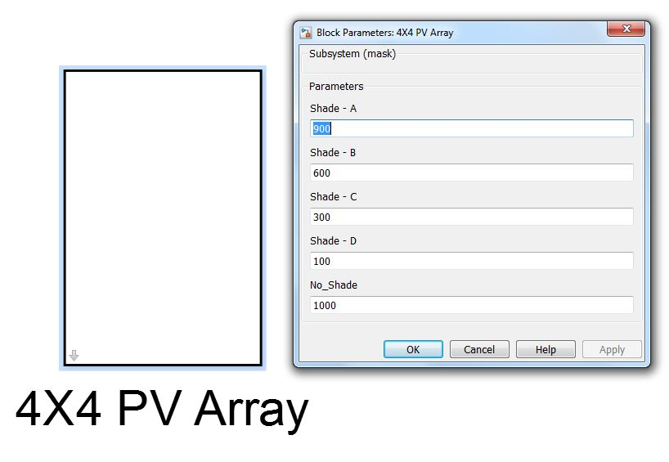
Simulink Model

Slide 21
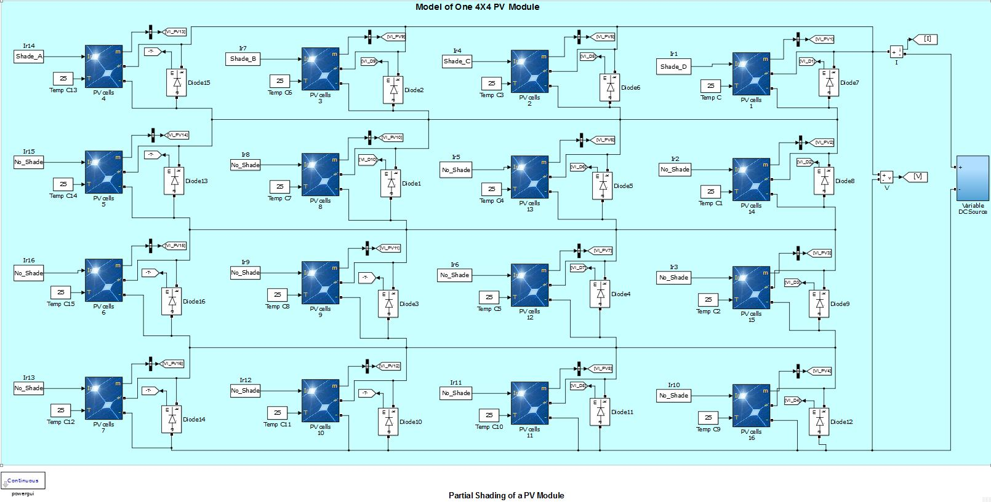
Simulink Model (contd.)

Slide 22
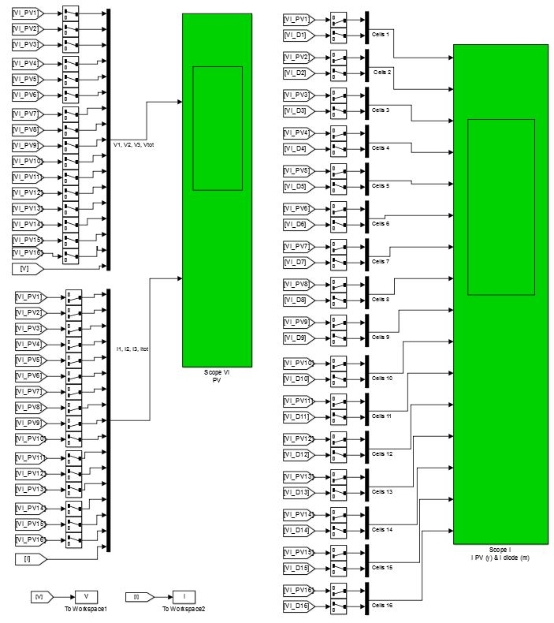
Simulink Model (contd.)

Slide 23
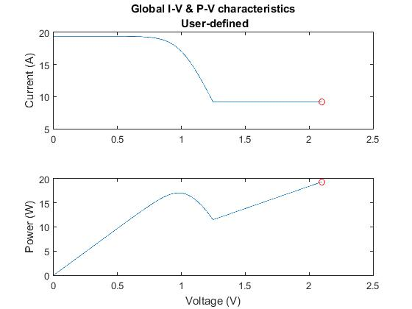
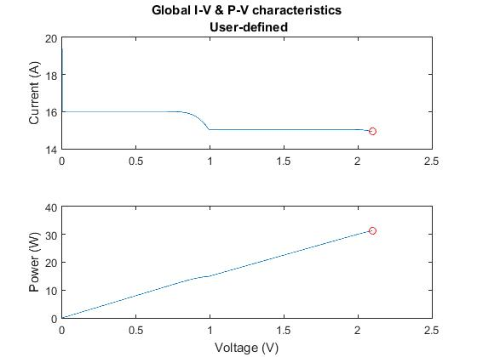
Results
TCT Configuration
Game Theory Re-Configuration

Slide 24
Advantages
Benefits of using Game Theory as observed are:
1. Better Power Output after re-configuration.
2. No Multiple Peaks , thus helps in
implementing MPPT.
3. Avoids using By-Pass Diodes hence helps in
eliminating diode power loss.
4. Cost-Effective Implementation

Slide 25
Limitations observed during implementation
A similar Implementation was tried for a 9x9 array but due huge memory requirements(~25GB for 9x9 array) for Matlab , This solution could not be implemented for 9x9 PV array on the computers in our lab.

Slide 26
References
[1] Shubhankar Niranjan Deshkar et al., “Solar PV array reconfiguration under partial shading conditions for maximum power extraction using genetic algorithm,” Renewable and Sustainable Energy Reviews 43 (2015): 102–110
[2] HOW SHADE AFFECTS A SOLAR ARRAY
Fig 1 :http://sargosis.com/how-shade-affects-a-solar-array/
Fig 3 : Shubhankar Niranjan Deshkar et al., “Solar PV array reconfiguration under partial shading conditions for maximum power extraction using genetic algorithm,” Renewable and Sustainable Energy Reviews 43 (2015): 102–110

